Slide 1

Single-Image Crowd Counting via Multi-Column Convolutional Neural Network
Written by
Yingying Zhang Desen Zhou Siqin Chen Shenghua Gao Yi Ma
Shanghaitech University
Presented by
Reeda Saeed (CS1946)

Slide 2
What is crowd counting ?
Crowd Counting is a technique to estimate the number of people in an image or a video.
Estimating crowds from images or videos has become an increasingly important application of Computer Vision Technology.

Slide 3
Crowd Counting use cases
Counting crowds in forbidden areas in a manufacturing unit to enforce safety rules and minimize health risks.
Managing high traffic roads and public spaces.
Counting attendance in educational institutions.
Urban Planning.
Video surveillance.

Slide 4
Earlier methods for crowd Counting
Detection Style Framework
Scans a detector over two consecutive frames of video sequence.
Limitations
Occlusion

Slide 5
Feature-based Regression
Segmenting the foreground, extracting various features and then applying regression function to estimate crowd count.
Limitations
Difficult to get accurate estimate.
CNN-based Method
It requires perspective map on both training and testing scenes.
Limitations
Perspective maps are not readily available.

Slide 6
Multi-column convolution neural network
Aim / Objective
Accurate crowd counting from an arbitrary still images with arbitrary camera perspective and crowd density.

Slide 7
Challenges
Foreground Segmentation
Without the information of scene geometry or motion it’s impossible to segment crowd from it’s background.
The density and distribution
Tremendous occlusion for most people in image.
Variation of Scale
We have to handle all the different scales.

Slide 8
Solution to the Challenges
A novel framework based on CNN for crowd counting in arbitrary still image is proposed.
It’s work is inspired from multi-column deep neural network.

Slide 9
How multi-column network works ?
In that model an arbitrary number of columns can be trained on inputs processed in different ways.
The final predictions are obtained by averaging individual predictions of all deep neural networks.

Slide 10
Working of Multi-Column Neural Network
It contains 3 columns of CNN
Filter size have different sizes
Input: Still image
Output: Crowd density-map

Slide 11
Why we adopt multi-column architecture?
Three columns correspond to filters with receptive fields of different sizes (large, medium and small).
Features learned by each column of CNN is adaptive.
Large variation in people/head size due to perspective effect on across different image-resolutions.

Slide 12
Replacing FC layer with Conv layer with 1x1 filter size
Input: image can be of arbitrary size to avoid distortion.
Output: estimation of the density of the crowd from which we derive overall count.

Slide 13
Dataset
Shangitech: randomly taken from the internet
1,200 images

Slide 14
MCNN FOR CROWD COUNTING
Density map based crowd-counting
To estimate the number of people in a given image 2 natural configurations are used:
First:
Input: Image
Output: Estimated head Count
Second:
Input: Image
Output: Density map of crowd(how many people per square meter) and then obtain the head count by integration

Slide 15
Density map based crowd counting
Density map preserve more information.
Density map gives the spatial distribution of crowd.
If density in small region is much higher than in other region it can indicate something abnormal happens there.
In learning density map via CNN, the learned filters are more adaptive to different head sizes, hence more suitable for arbitrary inputs.

Slide 16
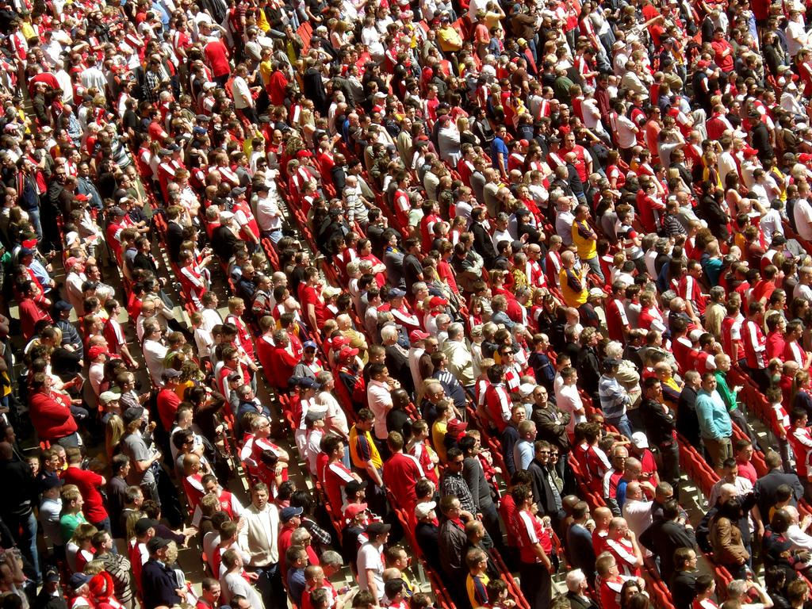
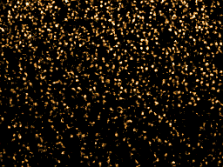
16
32
16
Pooling:2x2
Pooling:2x2
8
Conv: 5x5
Conv: 7x7
Conv: 7x7
Conv: 9x9
Conv: 7x7
20
40
20
10
30
Conv: 7x7
Pooling:2x2
Pooling:2x2
Conv: 5x5
Conv: 5x5
Conv: 1x1
Conv: 5x5
Conv: 5x5
Input Image
Density Map
Merged Feature Map
24
Conv: 7x7
Conv: 5x5
48
24
12
Pooling:2x2
Pooling:2x2
Conv: 3x3
Conv: 3x3
Conv: 5x5

Slide 17
EXPERIMENTS
Dataset: Shanghaitech
MCNN (results generated by me using author pretrained weights)
MCNN (trained from scratch by me)
CNN with transfer learning (on pretrained VGG16 weights)

Slide 18
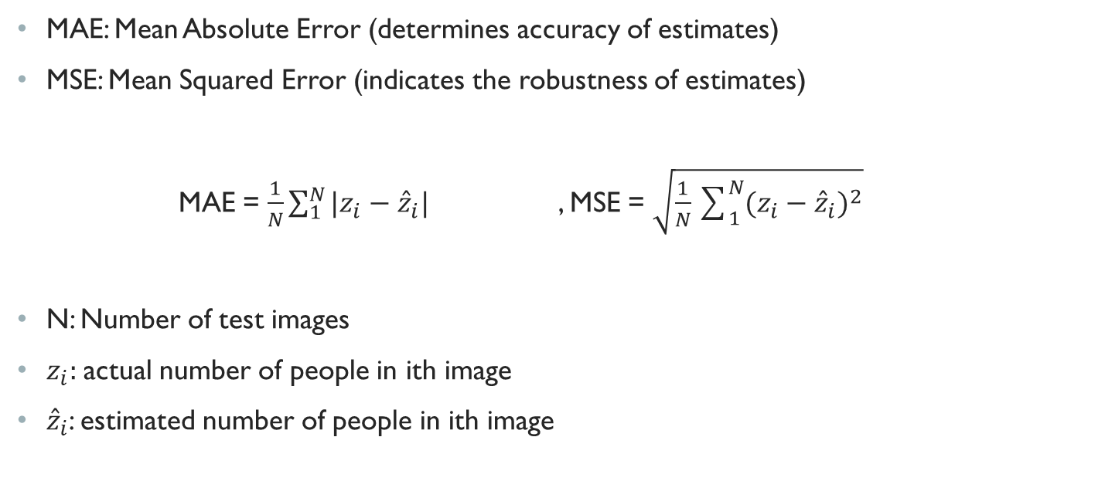
EVALUATION METRIC
MAE: Mean Absolute Error (determines accuracy of estimates)
MSE: Mean Squared Error (indicates the robustness of estimates)
MAE = $\frac{1}{N}\sum_{1}^{N}{{|z}_{i}}−{\hat{z}}_{i}|$ , MSE = $\sqrt{{\frac{1}{N}\sum_{1}^{N}{{(z}_{i}}−{\hat{z}}_{i})}^{2}}$
N: Number of test images
$z_{i}:$actual number of people in ith image
${\hat{z}}_{i}$: estimated number of people in ith image

Slide 19
Results
Method | MAE | MSE
MCNN (results generated by author) | 110.2 | 173.2
MCNN (results generated by me using author pretrained weights) | 110.19 | 169.37
MCNN (trained from scratch by me) | 189.63 | 246.96
CNN with transfer learning (on pretrained VGG16 weights) | 75.7 | 112.33

Slide 20
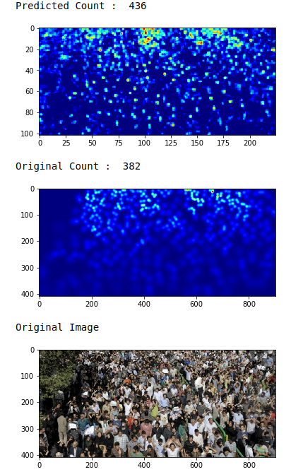
COMPARISON
MCNN (results generated by me using author pretrained weights)

Slide 21
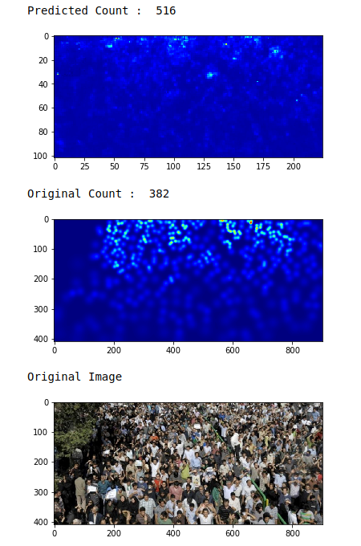
MCNN (trained from scratch by me)

Slide 22
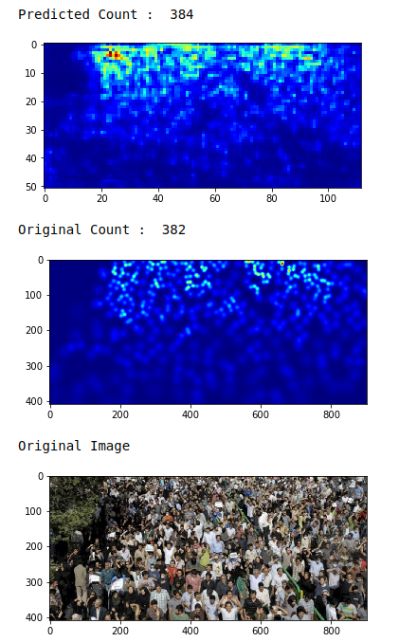
CNN with transfer learning (on pretrained VGG16 weights)

Slide 23
References
Zhang Y, Zhou D, Chen S, Gao S, Ma Y. Single-image crowd counting via multi-column convolutional neural network. InProceedings of the IEEE conference on computer vision and pattern recognition 2016 (pp. 589-597).
https://nanonets.com/blog/crowd-counting-review/#counting-by-estimating-the-density
https://boominathanlokesh.wordpress.com/collaborative-learning-application-in-crowd-counting/
Wang Z, Deng Q, Zhao Y. The Comparison of Crowd Counting Algorithms based on Computer Vision. InJournal of Physics: Conference Series 2019 Apr (Vol. 1187, No. 4, p. 042012). IOP Publishing.

